Slide 1
Leaning Learning Fast
Here is where your presentation begins

Slide 2
Table of contents
01
02
03
What’s learn and learn fast?
Why do we need to learn fast?
How to learn fast

Slide 3
What’s learn and learn fast
01

Slide 4

What’s learn and learn fast?
Learn: to get new knowledge or skill in subject or activity.
Learn fast: it same learn but faster.

Slide 5
— Anonymous Person (D** V* :>)
“Knowledge is what remains after the learning process”

Slide 6
Why do we need to learn fast?
02

Slide 7
Why do we need to learn fast?
Saving Time
Competitive Edge
Keep up with innovation
Brain Development

Slide 8
03
How to learn fast?

Slide 9
How to learn fast?
01
02
03
04
Set clear Goals
Break down into small sections
Arrange Priority
Practice

Slide 10

How to learn fast?
01
Set clear Goals
Define your learning objectives.
Knowing what you want to achieve will help you stay focused and motivated.

Slide 11
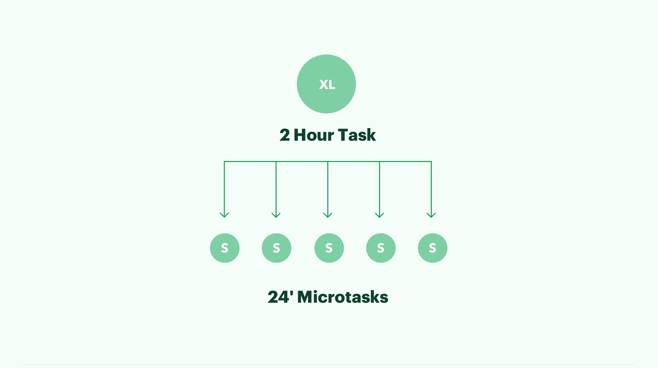
How to learn fast?
02
Break down into small sections
Small problems are always easier to solve than big problems.
Don’t learn everything, just learn the important things.

Slide 12

How to learn fast?
03
Arrange Priority
Solve important and necessary problems before completing the rest.

Slide 13
How to learn fast?
03
Practice
Practice is the best way to remember what you have learned.

Slide 14
Bonus
There are many ways to learn: Teach what you are learning, learn in multiple ways, … . You can find out what suits you, and you can also combine them to achieve better results.
Utilize Technology: ChatGPT , Copilot,….

Slide 15
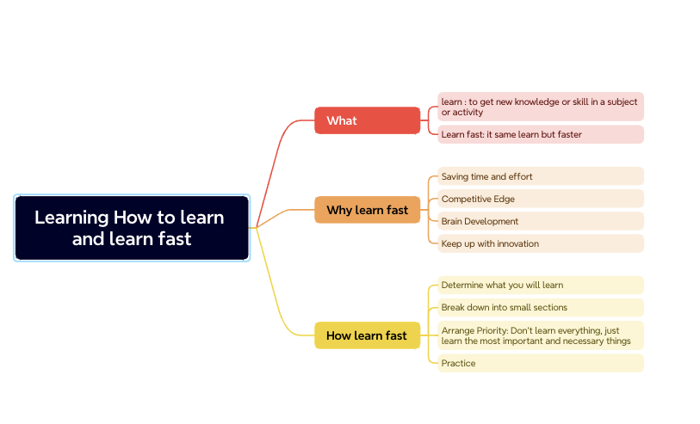
Mind Map

Slide 16
Thanks!

